Slide 1
HELP International NGO CASE STUDY SUBMISSION
Submitted By : Shivali Dalmia

Slide 2
PROBLEM STATEMENT
Problem:
HELP international NGO needs to know the countries which are in direst aid of need. They want to channelize their money strategically and effectively to help the areas in need.
Goal of Analysis:
Categorize countries by analysing certain socio economic and health factors that determine the overall development of the country.
Identify the countries which are in most need of help to progress on their overall development.
Recommend some countries to invest in.

Slide 3
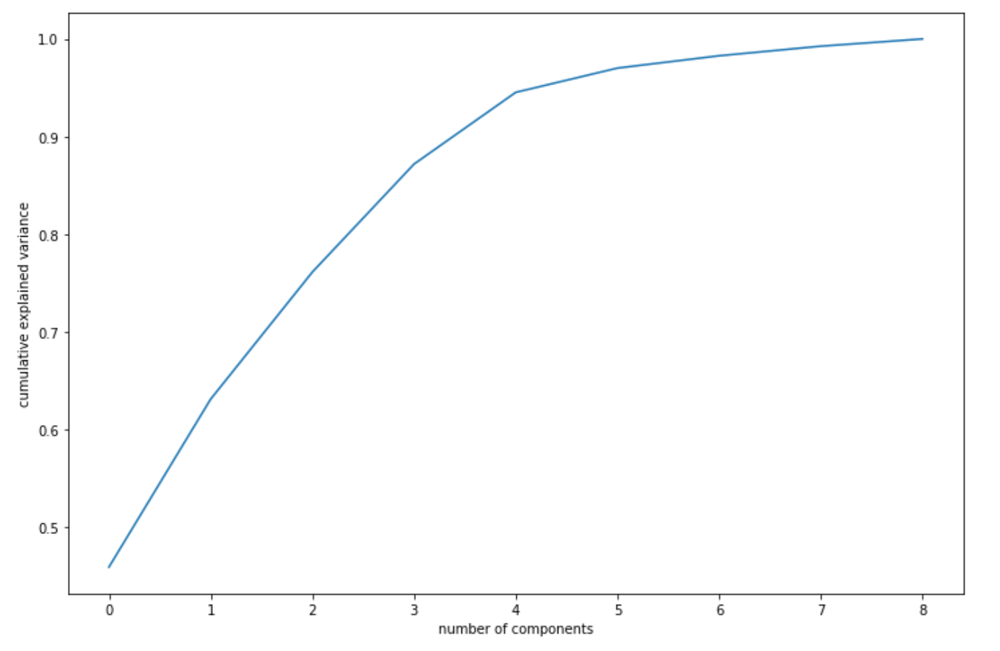
Analysis Approach
Use SKLEARN StandardScaler.
Step-1 Step-2
Step-3
After cleaning the master data , perform EDA to identify important factors.
Standardize the data to bring it on common scale for effective comparison.
Perform Principal Component Analysis(PCA) on standardized data.
Plot scree graph to depict the relation between variance of data and no of principal components.
5 principal components capture approximately 95% of variance.
Contd. On next slide

Slide 4
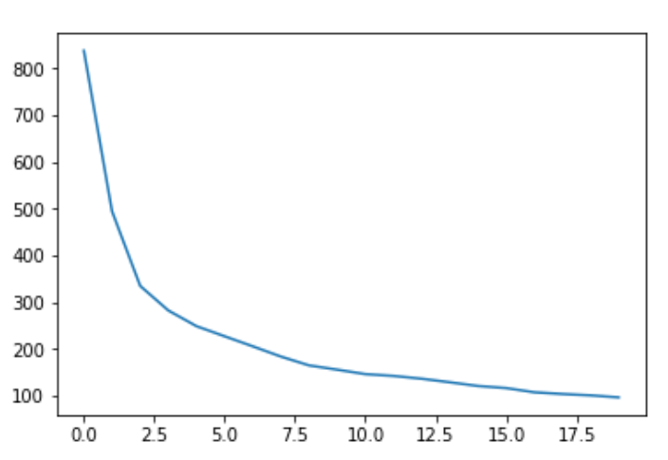
Step - 4
Step - 5
Perform outlier analysis on PCA’s chosen (PC1 to PC5).
Use IQR method to remove the outliers completely which can disrupt the cluster formations.
Check how well is data clustered using Hopkins statistics (0.73 close to 1)
Plot elbow curve to decide on optimum no of clusters.
K=5 is optimum as after that graph becomes flat.
Apply K-means algorithm by deciding initial no of clusters (k =3/5).
K=5 is chosen as optimum no of clusters to be formed.

Slide 5
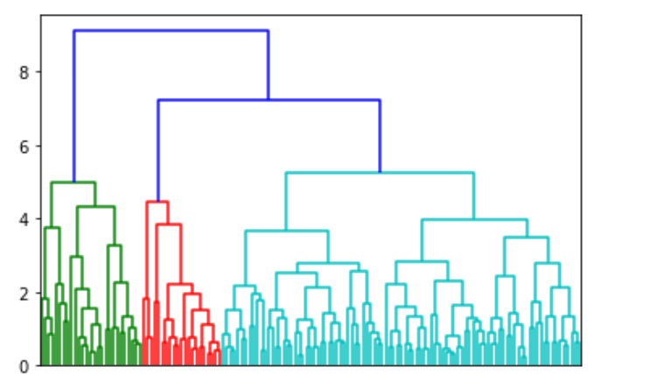
Step - 6
Step - 7
Apply hierarchical clustering to decide on no of clusters to be chosen.
K=5 comes to be the optimum value for no of clusters by cutting dendogram by a horizontal line.
Combine the master country data set with principal components derived during PCA
Perform mean analysis for important principal components and original columns for all 5 clusters.

Slide 6
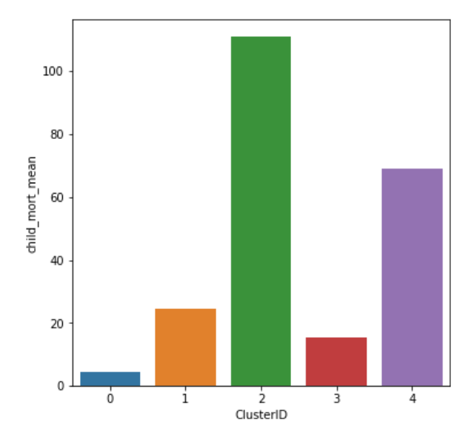
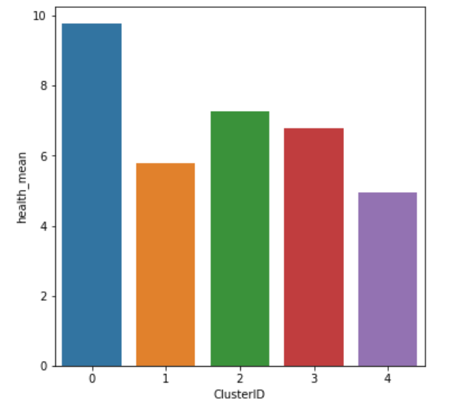
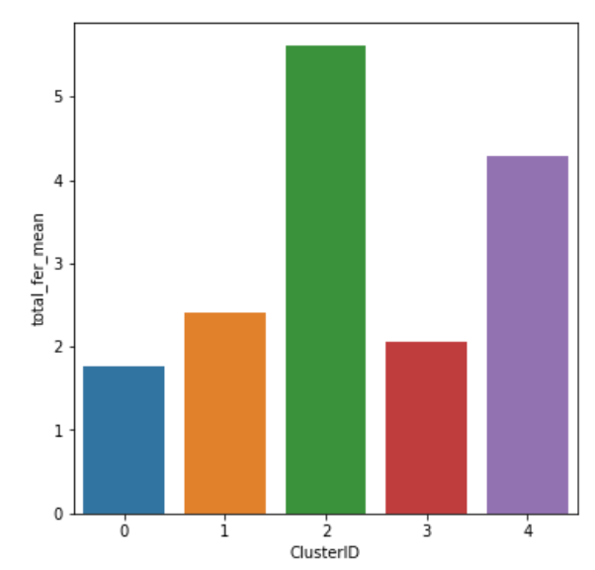
Feature mean analsysis
PC1,PC2 , PC3 , PC4 , PC5 , child mortality rate, total health expenditure , total fertility rate are chosen to be most important parameters to decide on clusters which needs help.
From below plots we can see that PC1 can be seen as a linear combination of income,life_expectancy and gdpp parameters as they all
are highest in cluster 0 and lowest in cluster 2.
PC2 can be seen related to inflation original parameter as both are highest in cluster 4 and lowest in cluster 0.
Cluster 0 – Lowest (Good) Cluster 0 – Highest Cluster 0 – Lowest (Good)
Cluster 2 – Highest (Bad) Cluster 4 – Lowest Cluster 2 – Highest (Bad)

Slide 7
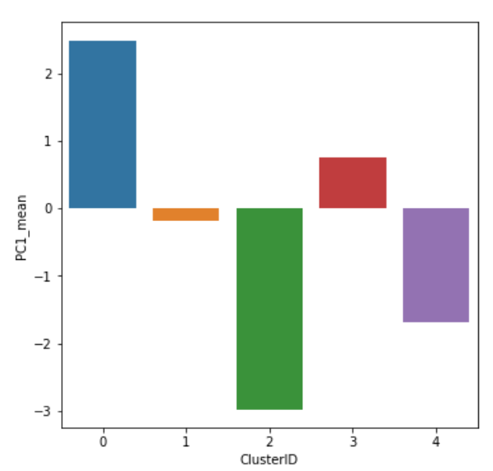
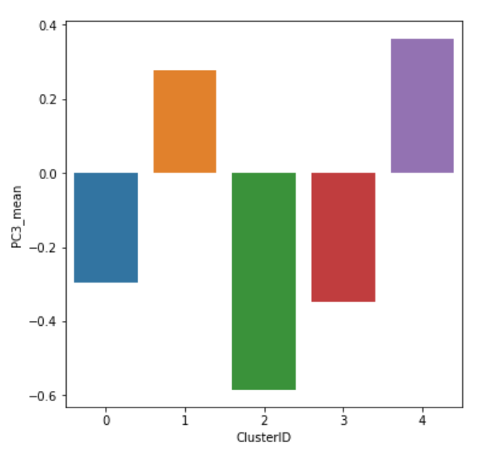
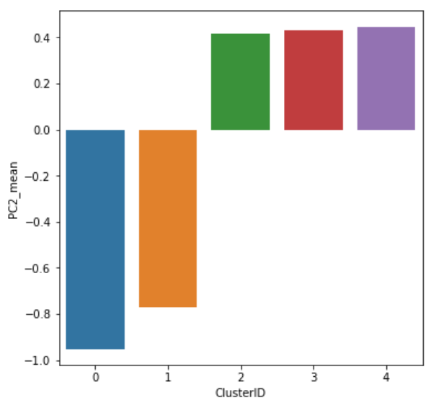
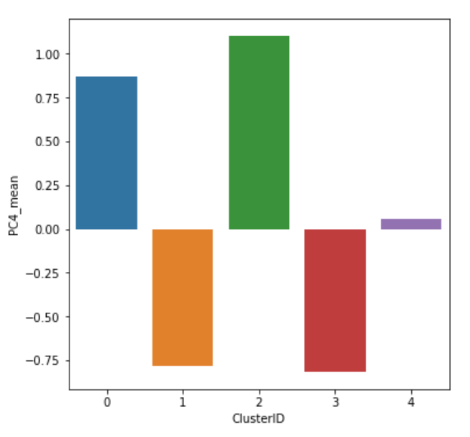
Principal Component Mean Analysis
PC Cluster 0 – Highest (High income, life_expec ,GDP) Cluster 4 – Highest
Cluster 2 – Lowest (Low income, life_expec,GDP) Cluster 2 - Lowest
Cluster 0 – Lowest (Low inflation) Cluster 2 - Highest
Cluster 2/3/4 – Highest (High inflation) Cluster 3 - Lowest

Slide 8
Inferences
Cluster ID | Analysis
0 | Has lowest child mortality rate as due to highest income in this sector they have the ability to avail effective health benefits. As a result inflation is lowest in this cluster and life expectancy is highest .GDP is highest.
1 | Has moderately low child mortality rate but inflation is high , but gdp is quiet low.
2 | Has highest child mortality rate due to lowest income in this sector. As a result inflation is high in this cluster and life expectancy is lowest. GDP is lowest.
3 | Child mortality rate is second lowest , health expenditures are high , inflations are low , life expectancy rate is quiet high , gdp is second highest in this group.
4 | Second highest child_mortality_rate , low health expenditures , low income, highest inflation, low life_expec in comparison to other clusters, low gdp.
Conclusion : As per above table countries belonging to cluster 2 are the most direst one in need of investment in every sector , to intensify their growth of development.

Slide 9
Countries to be invested in.
country | ClusterID | child_mort | exports | health | imports | income | inflation | life_expec | total_fer | gdpp
Afghanistan | 2 | 90.2 | 10 | 7.58 | 44.9 | 1610 | 9.44 | 56.2 | 5.82 | 553
Burkina Faso | 2 | 116 | 19.2 | 6.74 | 29.6 | 1430 | 6.81 | 57.9 | 5.87 | 575
Burundi | 2 | 93.6 | 8.92 | 11.6 | 39.2 | 764 | 12.3 | 57.7 | 6.26 | 231
Chad | 2 | 150 | 36.8 | 4.53 | 43.5 | 1930 | 6.39 | 56.5 | 6.59 | 897
Congo, Dem. Rep. | 2 | 116 | 41.1 | 7.91 | 49.6 | 609 | 20.8 | 57.5 | 6.54 | 334
Cote d'Ivoire | 2 | 111 | 50.6 | 5.3 | 43.3 | 2690 | 5.39 | 56.3 | 5.27 | 1220
Guinea | 2 | 109 | 30.3 | 4.93 | 43.2 | 1190 | 16.1 | 58 | 5.34 | 648
Guinea-Bissau | 2 | 114 | 14.9 | 8.5 | 35.2 | 1390 | 2.97 | 55.6 | 5.05 | 547
Haiti | 2 | 208 | 15.3 | 6.91 | 64.7 | 1500 | 5.45 | 32.1 | 3.33 | 662
Malawi | 2 | 90.5 | 22.8 | 6.59 | 34.9 | 1030 | 12.1 | 53.1 | 5.31 | 459
Mali | 2 | 137 | 22.8 | 4.98 | 35.1 | 1870 | 4.37 | 59.5 | 6.55 | 708
Mozambique | 2 | 101 | 31.5 | 5.21 | 46.2 | 918 | 7.64 | 54.5 | 5.56 | 419
Niger | 2 | 123 | 22.2 | 5.16 | 49.1 | 814 | 2.55 | 58.8 | 7.49 | 348
Rwanda | 2 | 63.6 | 12 | 10.5 | 30 | 1350 | 2.61 | 64.6 | 4.51 | 563
Sierra Leone | 2 | 160 | 16.8 | 13.1 | 34.5 | 1220 | 17.2 | 55 | 5.2 | 399
Tanzania | 2 | 71.9 | 18.7 | 6.01 | 29.1 | 2090 | 9.25 | 59.3 | 5.43 | 702
Togo | 2 | 90.3 | 40.2 | 7.65 | 57.3 | 1210 | 1.18 | 58.7 | 4.87 | 488
Uganda | 2 | 81 | 17.1 | 9.01 | 28.6 | 1540 | 10.6 | 56.8 | 6.15 | 595
Zambia | 2 | 83.1 | 37 | 5.89 | 30.9 | 3280 | 14 | 52 | 5.4 | 1460

Slide 10


